Slide 1
Raspberry B+ relay and ADC module

Slide 2

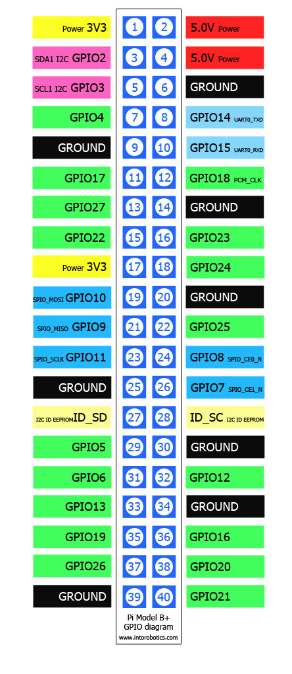

relay1
relay2
VDD
GND
SCL
16Bit I2C ADC+PGA
ADS1115
SDA
ADDR
ALRT
A0
A1
A2
A3

Slide 3
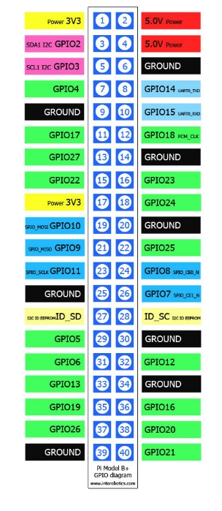

VDD
GND
GND
IN_1
IN_2
VCC
SCL
16Bit I2C ADC+PGA
ADS1115
relay1
SDA
ADDR
relay2
ALRT
A0
A1
A2
A3

